Slide 1
Chapter 2
The Big Picture

Slide 2
Database Models
Hierarchical Model.
Network Model.
Relational Model.
Object/Relational Model.
Object-Oriented Model.
Semistructured Model.

Slide 3
Hierarchical Model
Data is organized in a tree structure.
A hierarchy of parent and child data elements.
Suitable for 1:N mapping.
Example: employee data are linked to multiple children data.
Popular from the late 1960s, example: IBM IMS.

Slide 4
Network Model
Some data might have multiple parents.
Suitable for M:N mapping.
Support the set construct: an owner record type, a set name, and a member record type. An owner record type can also be a member or owner in another set.
A set defines a 1:M relationship, and the complete network of relationships is represented by several pairwise sets.

Slide 5
Relational Model
Developed by E.F. Codd in the 70’s.
Data is stored as tables (relations) with the properties:
Values are atomic.
Each row is unique.
Column values are of the same kind.
The sequence of columns is insignificant.
The sequence of rows is insignificant .
Each column has a unique name.

Slide 6
Object/Relational Model
Add new object storage capabilities to the relational systems.
To support complex objects such as time-series and geospatial data and diverse binary media such as audio, video, images, and applets.
Object methods support complex analytical and data manipulation operations to search and transform multimedia and other complex objects.
Example: IBM Informix, and Oracle.

Slide 7
Object-Oriented Model
According to Rao (1994), "The object-oriented database (OODB) paradigm is the combination of object-oriented programming language (OOPL) systems and persistent systems…”
One-to-one mapping of object programming language objects to database objects, no flattening and merging is needed for storage and retrieval of objects.
High performance management of complex objects and their relationships.

Slide 8
Semistructured Model
No schema, or some loose schema that is combined with data, self-describing, not strictly structured. Example: not all students might have emails or phones.
Modeled as graphs with semantic labeling.
Example: XML, RDF data.
Applications: Web data, data exchange, and data integration, B2B applications.

Slide 9
Our focus
The Relational Model

Slide 10
Table
Set of rows (no duplicates)
Each row describes a different entity
Each column states a particular fact about each entity
Each column has an associated domain
Domain of Status = {fresh, soph, junior, senior}
Id Name Address Status
1111 John 123 Main fresh
2222 Mary 321 Oak soph
1234 Bob 444 Pine soph
9999 Joan 777 Grand senior

Slide 11
Creating Tables
CREATE DATABASE test; USE test; CREATE TABLE Student (
Id INTEGER,
Name VARCHAR(20),
Address VARCHAR(50),
Status VARCHAR(10),
PRIMARY KEY (Id)
);

Slide 12
Insert into tables
INSERT INTO Student (Id, Name, Address, Status)
VALUES (1111,'John','123 Main','fresh'); INSERT INTO Student
VALUES(2222, 'Mary', '321 Oak', 'soph'); INSERT INTO Student
VALUES(1234, 'Joan', '777 Grand', 'soph');
OR
INSERT INTO Student (Id, Name, Address, Status)
VALUES (1111,'John','123 Main','fresh'), (2222, 'Mary', '321 Oak', 'soph'), (1234, 'Joan', '777 Grand', 'soph');

Slide 13
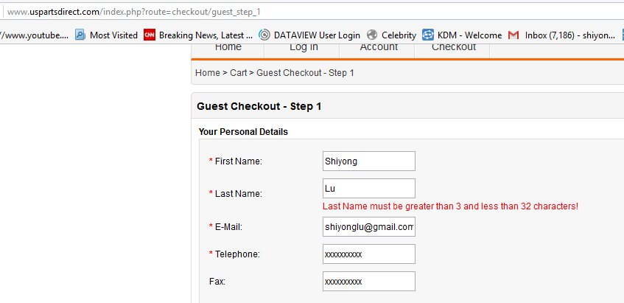
A bad design

Slide 14
Relation
Mathematical entity corresponding to a table
row ~ tuple
column ~ attribute
Values in a tuple are related to each other
John lives at 123 Main
Relation R can be thought of as predicate R
R(x,y,z) is true iff tuple (x,y,z) is in R

Slide 15
Operations
Operations on relations are precisely defined
Take relation(s) as argument, produce new relation as result
Unary (e.g., delete certain rows)
Binary (e.g., union, Cartesian product)
Corresponding operations defined on tables as well
Using mathematical properties, equivalence can be decided
Important for query optimization:
?
op1(T1,op2(T2)) = op3(op2(T1),T2)

Slide 16
Structured Query Language: SQL
Language for manipulating tables
Declarative – Statement specifies what needs to be obtained, not how it is to be achieved (e.g., how to access data, the order of operations)
Due to declarativity of SQL, DBMS determines evaluation strategy
This greatly simplifies application programs
But DBMS is not infallible: programmers should have an idea of strategies used by DBMS so they can design better tables, indices, statements, in such a way that DBMS can evaluate statements efficiently

Slide 17
Structured Query Language (SQL)
SELECT <attribute list>
FROM <table list >
WHERE <condition>
Language for constructing a new table from argument table(s).
FROM indicates source tables
WHERE indicates which rows to retain
It acts as a filter
SELECT indicates which columns to extract from retained rows
Projection
The result is a table.

Slide 18
Example
SELECT Name
FROM Student
WHERE Id > 4999;
Id Name Address Status
1234 John 123 Main fresh
5522 Mary 77 Pine senior
9876 Bill 83 Oak junior
Student
Name
Mary
Bill
Result

Slide 19
Examples
SELECT Id, Name FROM Student;
SELECT Id, Name FROM Student
WHERE Status = 'senior';
SELECT * FROM Student
WHERE Status = 'senior‘;
SELECT COUNT(*) FROM Student
WHERE Status = 'senior';
result is a table with one column and one row

Slide 20
More Complex Example
Goal: table in which each row names a senior and gives a course taken and grade
Combines information in two tables:
Student: Id, Name, Address, Status
Transcript: StudId, CrsCode, Semester, Grade
SELECT Name, CrsCode, Grade
FROM Student, Transcript
WHERE StudId = Id AND Status = 'senior';

Slide 21
Join
T1
T2
SELECT a1, b1
FROM T1, T2
WHERE a2 = b2
a1 a2 a3
A 1 xxy
B 17 rst
b1 b2
3.2 17
4.8 17
a1 a2 a3 b1 b2
A 1 xxy 3.2 17
A 1 xxy 4.8 17
B 17 rst 3.2 17
B 17 rst 4.8 17
FROM T1, T2
yields:
WHERE a2 = b2
yields:
B 17 rst 3.2 17
B 17 rst 4.8 17
SELECT a1, b1
yields result:
B 3.2
B 4.8

Slide 22
Modifying Tables
UPDATE Student
SET Status = 'soph'
WHERE Id = 111111111;
INSERT INTO Student (Id, Name, Address, Status)
VALUES (999999999, 'Bill', '432 Pine', 'senior')
DELETE FROM Student
WHERE Id = 111111111

Slide 23
Transactions
Many enterprises use databases to store information about their state
E.g., balances of all depositors
The occurrence of a real-world event that changes the enterprise state requires the execution of a program that changes the database state in a corresponding way
E.g., balance must be updated when you deposit
A transaction is a program that accesses the database in response to real-world events

Slide 24
Transactions
Transactions are not just ordinary programs
Additional requirements are placed on transactions (and particularly their execution environment) that go beyond the requirements placed on ordinary programs.
Atomicity
Consistency
Isolation
Durability
(explained next)
ACID properties

Slide 25
Integrity Constraints
Rules of the enterprise generally limit the occurrence of certain real-world events.
Student cannot register for a course if current number of registrants = maximum allowed
Correspondingly, allowable database states are restricted.
cur_reg <= max_reg
These limitations are expressed as integrity constraints, which are assertions that must be satisfied by the database state.

Slide 26
Consistency
Transaction designer must ensure that
IF the database is in a state that satisfies all integrity constraints when execution of a transaction is started
THEN when the transaction completes:
All integrity constraints are once again satisfied (constraints can be violated in intermediate states)
New database state satisfies specifications of transaction

Slide 27
Atomicity
A real-world event either happens or does not happen.
Student either registers or does not register.
Similarly, the system must ensure that either the transaction runs to completion (commits) or, if it does not complete, it has no effect at all (aborts).
This is not true of ordinary programs. A hardware or software failure could leave files partially updated.

Slide 28
Durability
The system must ensure that once a transaction commits its effect on the database state is not lost in spite of subsequent failures.
Not true of ordinary systems. For example, a media failure after a program terminates could cause the file system to be restored to a state that preceded the execution of the program.

Slide 29
Isolation
Deals with the execution of multiple transactions concurrently.
If the initial database state is consistent and accurately reflects the real-world state, then the serial (one after another) execution of a set of consistent transactions preserves consistency.
But serial execution is inadequate from a performance perspective.

Slide 30
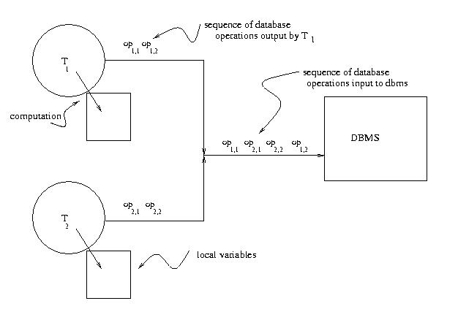
Concurrent Transaction Execution

Slide 31
Isolation
Concurrent (interleaved) execution of a set of transactions offers performance benefits, but might not be correct.
Example: Two students execute the course registration transaction at about the same time
(cur_reg is the number of current registrants)
T₁: read(cur_reg : 29) write(cur_reg : 30)
T₂: read(cur_reg : 29) write(cur_reg : 30)
time →
Result: Database state no longer corresponds to
real-world state, integrity constraint violated.

Slide 32
Isolation
The effect of concurrently executing a set of transactions must be the same as if they had executed serially in some order
The execution is thus not serial, but serializable
Serializable execution has better performance than serial, but performance might still be inadequate. Database systems offer several isolation levels with different performance characteristics (but some guarantee correctness only for certain kinds of transactions – not in general)

Slide 33
ACID Properties
The transaction monitor is responsible for ensuring atomicity, durability, and (the requested level of) isolation.
Hence it provides the abstraction of failure-free, non-concurrent environment, greatly simplifying the task of the transaction designer.
The transaction designer is responsible for ensuring the consistency of each transaction, but doesn’t need to worry about concurrency and system failures.

Slide 34
Workflows
Originated from business reengineering and office automation in 1970s.
A workflow models a business process consisting of a set of tasks, some of which might be transactions, other might be long-running activities with ACID relaxed.
A workflow management system (WFMS) supports the specification, execution, and monitoring, and failure handing of workflows.
Example: Microsoft Windows Workflow Foundation.

Slide 35
A business workflow example
S. Lu, 2002

Slide 36
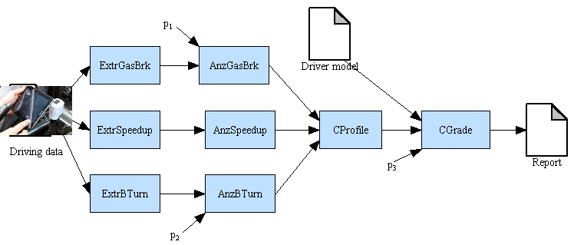
A scientific workflow example
www.dataview.org

Slide 37
Exercise 3
Try test3.java using your own MySQL database, to compile
javac -cp .;lib\classes12.zip;lib\mysql-connector-java-5.1.32-bin.jar test3.java
To run
java -cp .;lib\classes12.zip;lib\mysql-connector-java-5.1.32-bin.jar test3
Try all the SQL statements in this chapter by modifying test3.java

Slide 38
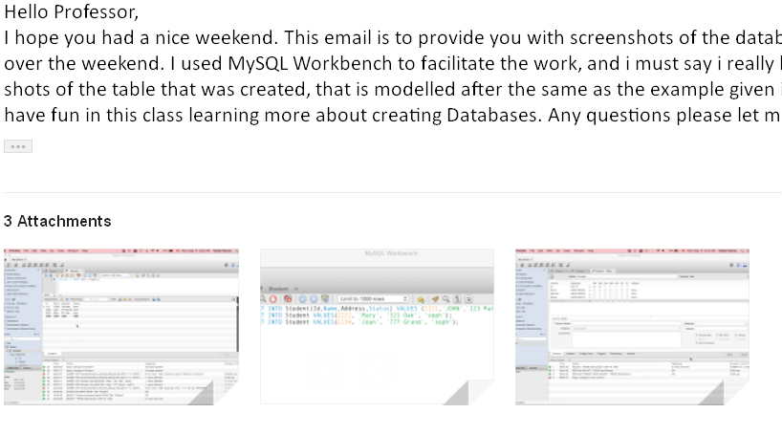
A student’s exercise example
Attitude, Skill, and Knowledge!

